Slide 1
Collision of three objects in one dimension

Slide 2
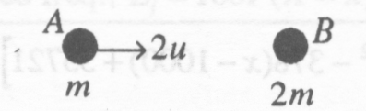
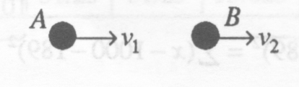
Eg 1 Three particles A, B and C have masses m, 2m and m respectively. The particles are in the order ABC in a straight line on a smooth horizontal plane. Initially A is moving towards B with speed 2u, B is at rest, and C is moving towards B with speed u. The first collision is between A and B. The coefficient of restitution between
any pair of particles is . Show that, after the first collision between A
and B, the speed of B is u and find, in terms of m and u, the
magnitude of the impulse between A and B in this collision.
Show that the speed of B after its collision with C is u and find, in
the form kmu², the total kinetic energy lost in the two collisions, giving the value of k correct to three significant figures.
Solution:
First collision:
Before Impact
After Impact

